Slide 1
Testing APIs
Ishaan Malik

Slide 2
API Testing
API testing is a type of software testing that validates the business logic layer of an application, verifying that the APIs meet functional, performance, security, and reliability requirements.
By acting as the intermediary between the front-end and back-end, testing the API layer enables teams to catch bugs early in development before the visual application is fully built.
Unlike frontend UI testing which focuses on graphical elements, API testing bypasses the user interface to directly communicate with backend services using structured data requests and responses.

Slide 3
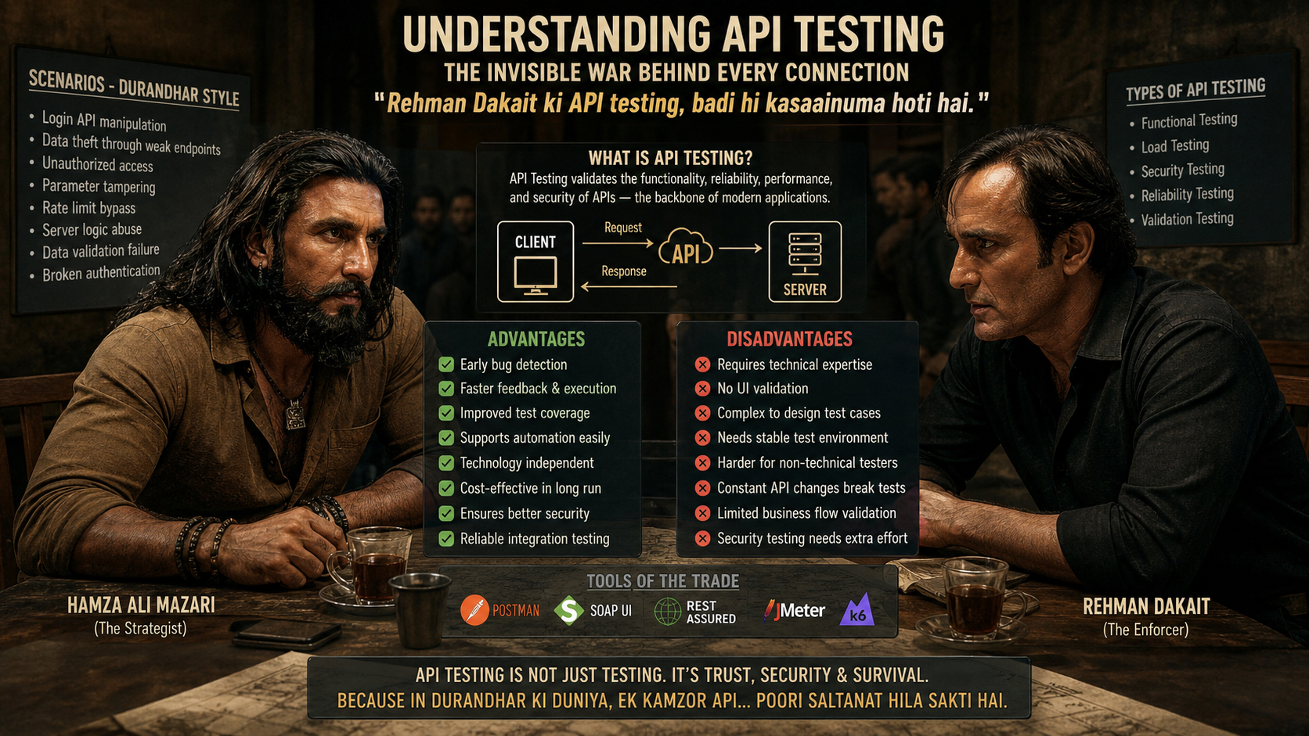

Slide 4
Core Concepts of API Testing
To effectively test an API, developers and QA teams construct specific requests to an endpoint (a resource URL) and evaluate the server's response. Key elements checked during this loop include:
HTTP Methods: Verifying the action being taken, such as GET (read), POST (create), PUT (update), or DELETE (remove).
Status Codes: Checking the numeric indicators returned by the server, such as 200 OK for success, 400 Bad Request for client-side errors, or 500 Internal Server Error for system breakdowns.
Payload Data: Validating the structure and contents of the sent and received data, typically formatted as JSON or XML.
Headers: Inspecting the request and response metadata containing authorization details, content types, and caching instructions.

Slide 5
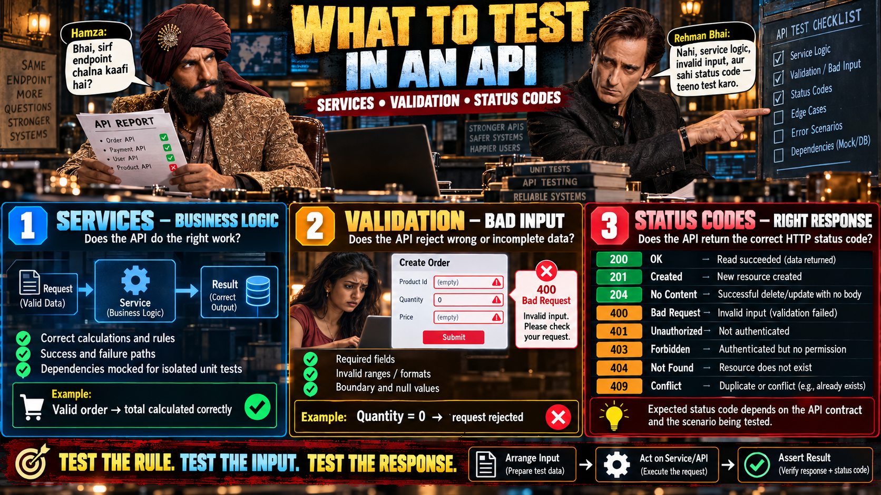

Slide 6
Testing Pyramid
The pyramid is a model for deciding how many tests to write at each level.
It has three layers, from bottom to top: unit tests, integration tests and end-to-end (E2E) tests.
The advice is many unit tests, fewer integration tests and very few E2E tests.
A common starting ratio is about 70% unit, 20% integration and 10% E2E.

Slide 7
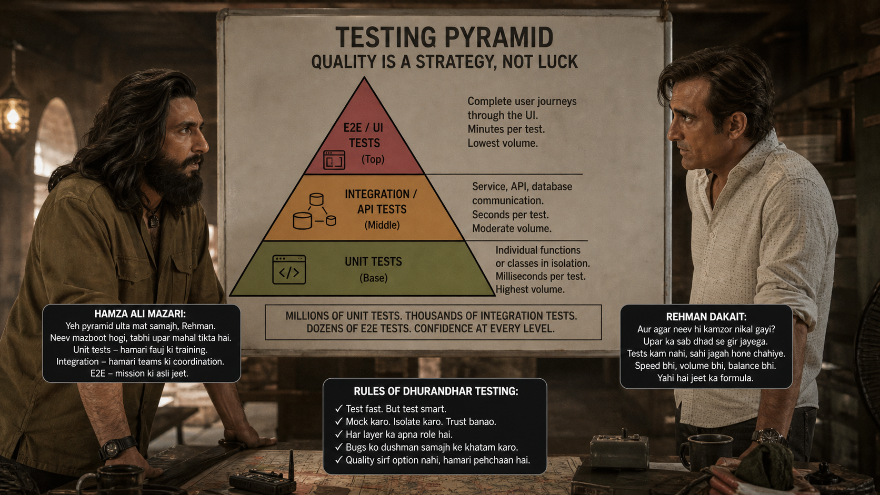

Slide 8
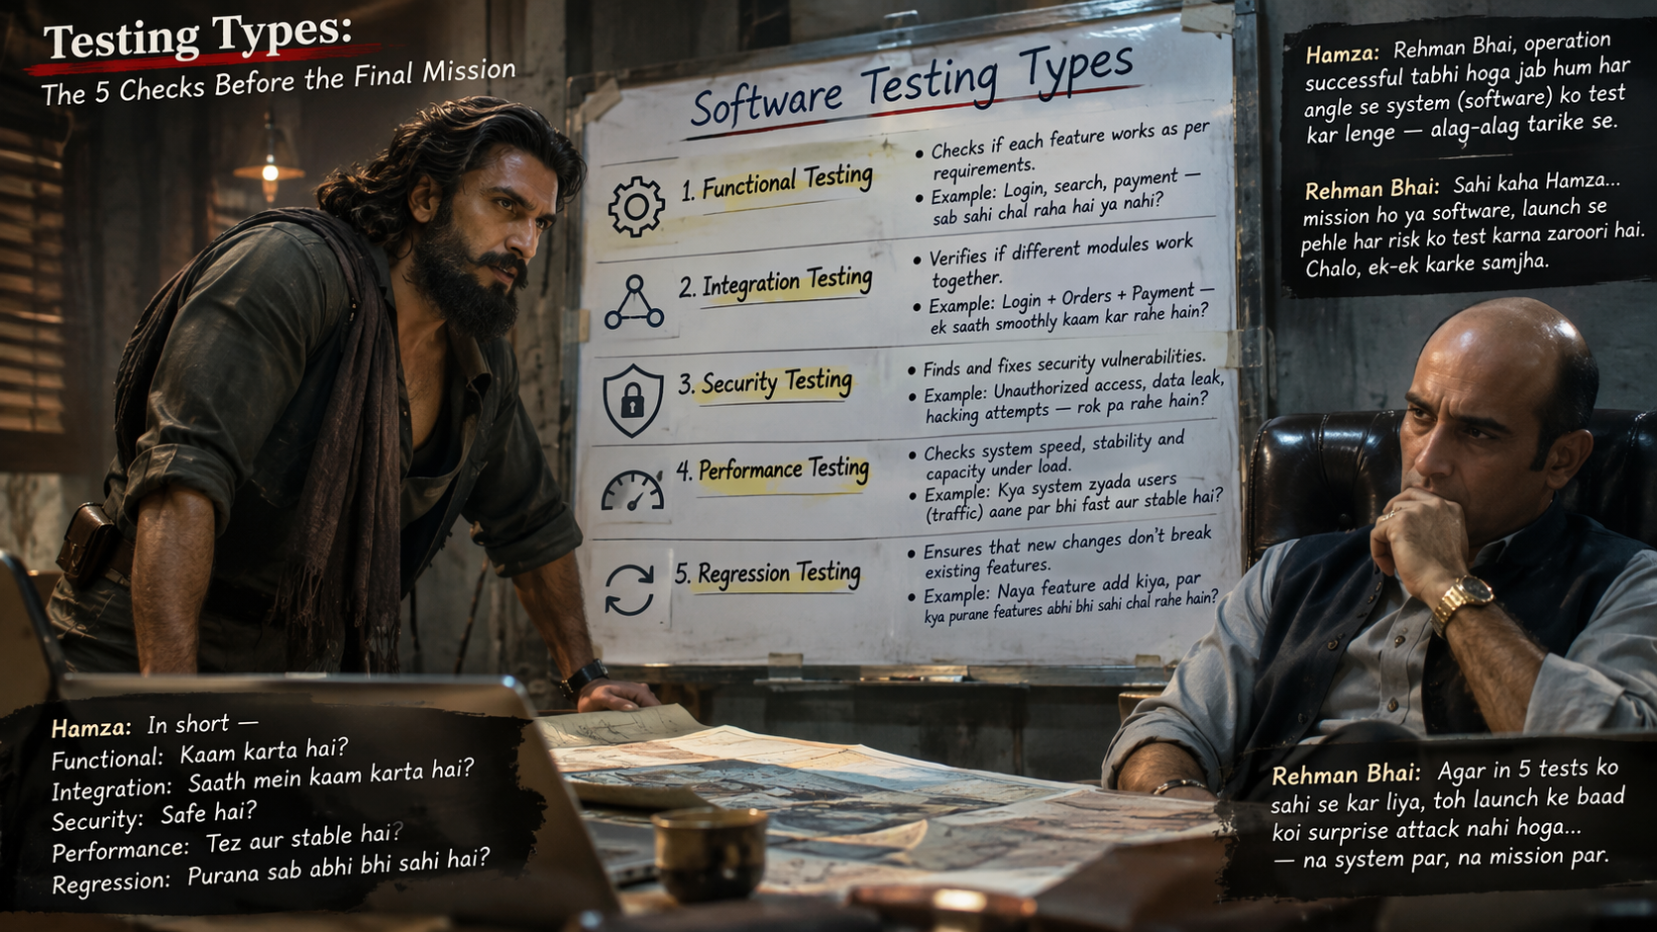
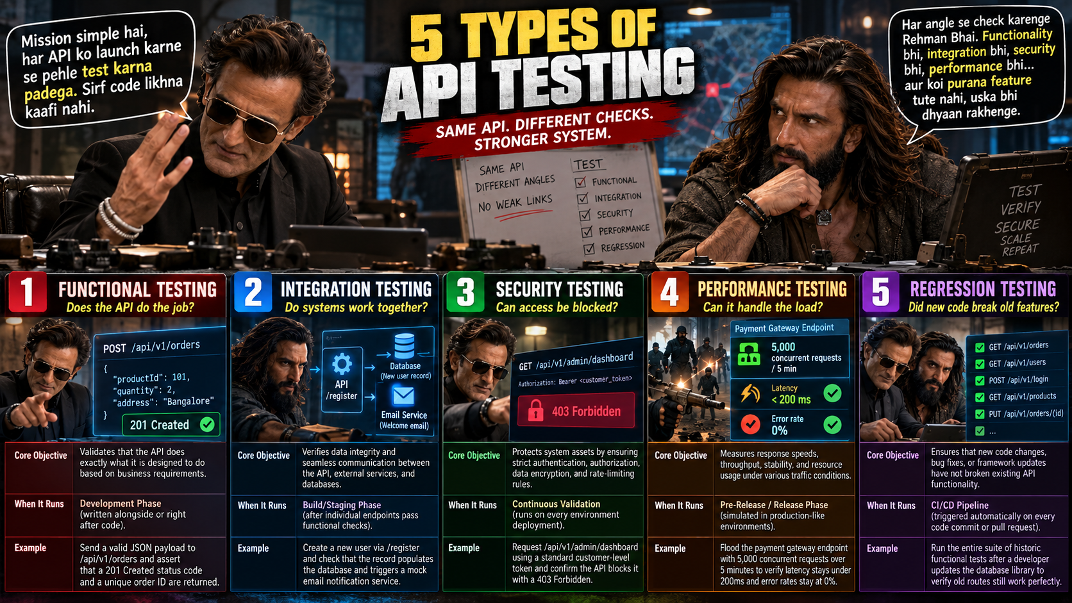

Slide 9


Slide 10
Unit Testing Methods
When writing integration or unit tests that interact with data, developers choose between two primary strategies to test code: Mocking or using an In-Memory/Test Database.
Attribute | Mocking | In-Memory / Test Database
What it does | Replaces your database adapter with simulated data structures that hardcode specific responses. | Spins up a temporary, light database instance that actually executes queries and saves data in RAM.
Test Classification | Unit Testing (Zero real external infrastructure). | Integration Testing (Tests code boundary and data persistence layer).
Layer Tested | Code logic only (bypasses database, query generation, and constraints). | Code logic, database queries, ORM mapping, relationships, and basic integrity constraints
Execution Speed | Extremely Fast (Runs in microseconds; no network or disk I/O overhead). | Slower (Slower than mocking due to setup/teardown and execution cycles, but much faster than physical DBs).
Maintenance | High (Tests break frequently if code internals or variable names change, even if logic remains correct). | Low (Tests stay resilient because they focus on inputs and outputs, not internal data structures).
Risk Profile | High risk of false positives (A broken SQL query can still pass if the mock returns the expected object). | Low risk (Catches invalid queries, missing tables, or constraint violations before deployment).

Slide 11
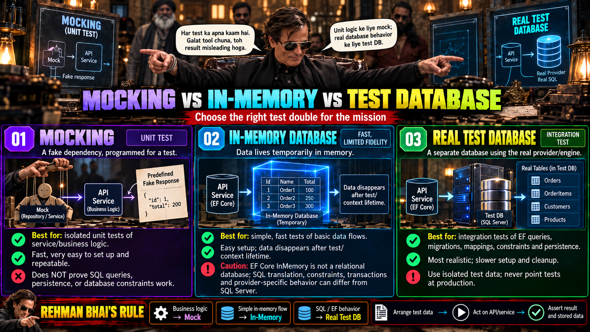

Slide 12
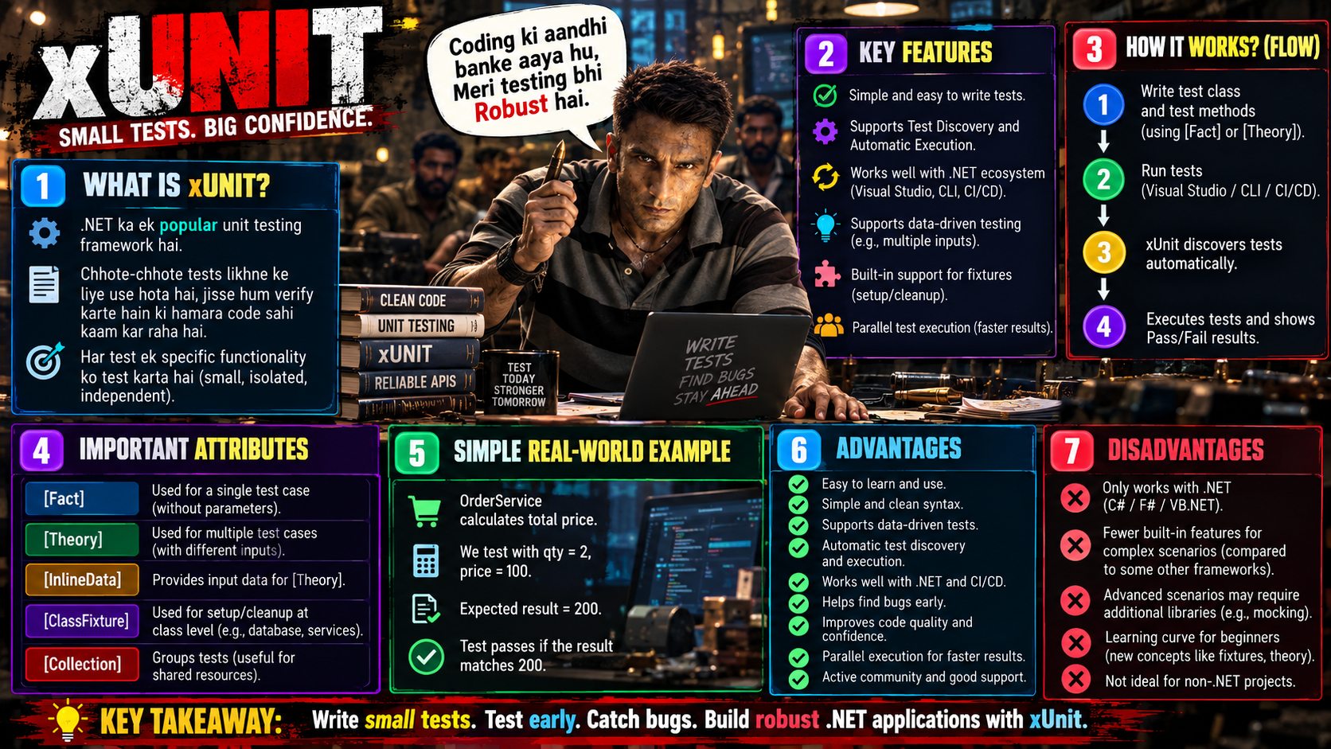

Slide 13
Quick Quiz
Which of the following accurately describes the structure and philosophy of the Testing Pyramid?
It features a large layer of end-to-end UI tests at the bottom, supported by small unit tests at the top.
It suggests a large base of fast, low-level unit tests, progressing upward to fewer, slower end-to-end UI tests.
It mandates an equal number of unit, integration, and UI tests distributed evenly across all three tiers.
It prioritizes manual QA testing over automated tests, keeping automated checks as a secondary verification step.
Answer: B

Slide 14
Quick Quiz
During the execution of a test structured with the Arrange-Act-Assert (AAA) pattern, which activity specifically belongs to the "Arrange" phase?
Verifying that the returned value matches the expected output or exception type.
Invoking the target method or operation being tested under the system under test.
Setting up test data, initializing object instances, and configuring mock expectations.
Disposing of database connections and cleaning up global environment variables.
Answer: C

Slide 15
Quick Quiz
When deciding whether to use a mock object or an in-memory database for testing a data-driven repository, which scenario best justifies using a mock?
When you want absolute isolation of a unit by substituting dependency behavior and avoiding any execution of database engine logic or schema constraints.
When you need to verify complex LINQ query translation and database-specific constraint violations.
When you want to test end-to-end transactional integrity across multiple database tables.
When you require persistent data storage across multiple isolated test fixture runs.
Answer: A

Slide 16
Quick Quiz
In the xUnit testing framework, what is the key distinction between the [Fact] attribute and the [Theory] attribute?
[Fact] is used for asynchronous tests, whereas [Theory] is used exclusively for synchronous tests.
[Fact] requires parameter inputs from data sources, whereas [Theory] takes no arguments.
[Fact] runs in parallel by default, whereas [Theory] forces sequential execution.
[Fact] represents an invariant test that takes no arguments, whereas [Theory] represents a test suite that is true for a set of data inputs.
Answer: D

Slide 17
Q&A
The End

